Slide 1
Capstone Project
Title :- Suggesting best trading option for a perishable food crop for a state among the states across India.
Data 606
Instructor:- Dr.Chaojie Wang

Slide 2
Importance of this issue
Indian economy mostly depends on agriculture
Perishable food crops are the crops that must be transported and used with in 2-3 weeks of harvesting.
Farm price of a particular crop varies in different seasons in a particular sate and also varies in different states in a particular season
Effective trade system is mandatory to regulate the perishable food crop prices

Slide 3
How I am going to address this Issue
I want to design a machine learning model which can suggest me best set of sates to trade with for a particular crop in a particular season.
In case of importing a perishable food crop it should suggest the set of sates so that the import price is less.
In case of exporting a food crop, I want the model to suggest me best set of states to trade with so that farmers will get higher farm price.

Slide 4
Other Issues that can be addressed using this model
Predicting most profitable crop for that season
Helping traders to make high profit margins

Slide 5
Factors that effect the farm price
Climatic Conditions:-
  Sunlight
  Precipitation
  Temperature
  Wind Speed
Soil Conditions

Slide 6
About Datasets
1) )Monthly data of different perishable cops at different states across the country.
  Note: - In my project I am taking top 10 most produced perishable crop datasets from January 2011 till December 2020.
  Source: - National Horticulture Board of India
  Link: - http://nhb.gov.in/OnlineClient/MonthlyPriceAndArrivalReport.aspx?enc=3ZOO8K5CzcdC/Yq6HcdIxJ4o5jmAcGG5QGUXX3BlAP4=
  Link to Dataset in my Google Drive(Anyone from UMBC group can access it): - https://drive.google.com/drive/folders/1OxtPZU1gt_ehgOiGhl_hpdmPWlvjO2ZW?usp=sharing
  Attributes of the datasets: - Each individual dataset consists of 6 attributes, namely
  Centre Name, Year, Month, W.sale avg.price, Retail Avg.price and Total Arrival

Slide 7
2)Monthly historical weather and soil report of each sate in India from January 2010 till December 2020.
  Source: - NASA’s Data Access Viewer: - Its Provides solar and meteorological data sets from NASA research for support of renewable energy, building energy efficiency and agricultural needs.
  Link: - https://power.larc.nasa.gov/data-access-viewer/ 2.3) Link to Dataset in my Google Drive(Anyone from UMBC group can access it):- https://drive.google.com/drive/folders/15zXCuLByVlfpdg5eg_yfT2qBmqdDHeif?usp=sharing
  Attributes of the Datasets: -
    All Sky Surface PAR Total
    Dew/Frost Point at 2 Meters
    Temperature at 2 Meters Maximum
    Temperature at 2 Meters Minimum
    Specific Humidity at 2 Meters
    Precipitable Water
    Wind Speed at 2 Meters Maximum
    Wind Speed at 2 Meters Minimum
    Surface Soil Wetness
    Root Zone Soil Wetness Profile Soil Moisture

Slide 8
ML Models:-
I will be using supervised learning techniques in my algorithm. As of now I think of two different techniques to design the model.
Using Multi-Class Multi Label Classification Algorithms
  Implementation:- Under this Multi-Class classification I plan to divide the farm price of each crop into 3 or 4 different slabs such as high profit margin, low profit margin or loss and predict under which slab a particular crop can fall given all the features.
  Algorithms:- I will try to train my model using multi-class classification machine learning algorithms such as k-Nearest Neighbor’s, Decision Trees, Naive Bayes etc...
  Performance Metrics :- Precision and Recall values and F1 score

Slide 9
Regression Methods
2) Using Regression Methods
  Using regression algorithms to train my model and predict the farm price of a perishable food crop.
  Algorithms:- Neural Networks or LASSO regression(As I feel there is good co-relation between by features)
  Performance Metrics:- Mean Square Error or Mean Absolute Errors

Slide 10
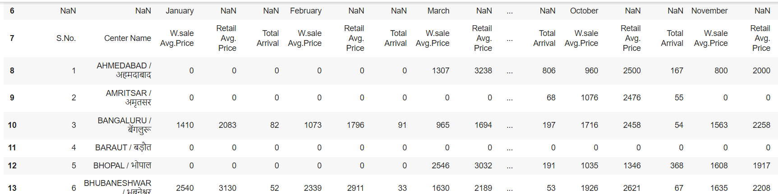
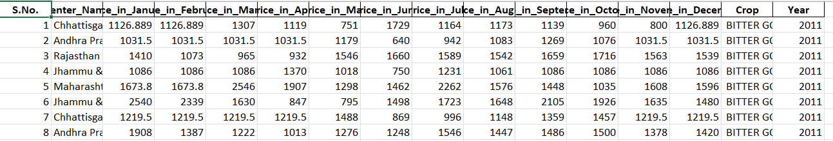
EDA of Crops Dataset:-
Combined 110 different datasets
Deleting unwanted rows, Deleting unwanted columns, Renaming the header values, Reshaping the data frame, Fill null values, Resetting index

Slide 11
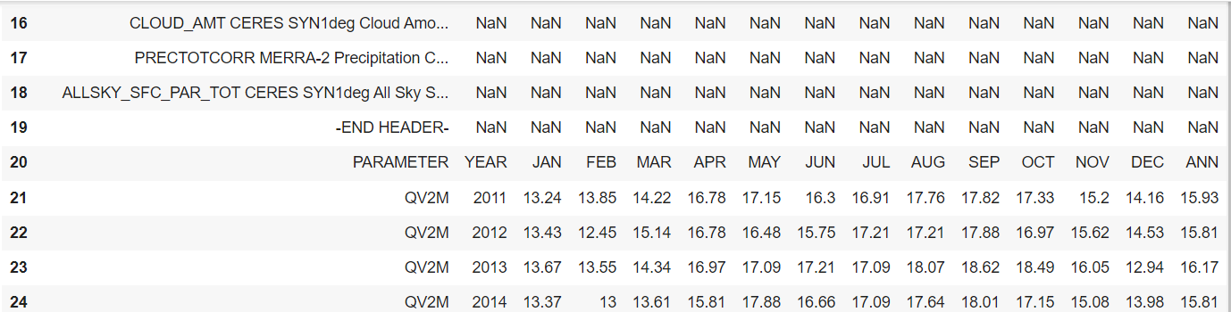
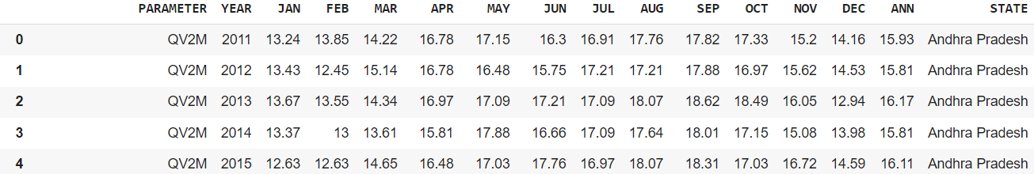
EDA of weather datasets
Combined 29 states weather datasets
Appended individual data frames, No nulls, Renaming the header values, Reshaping the data frame.

Slide 12
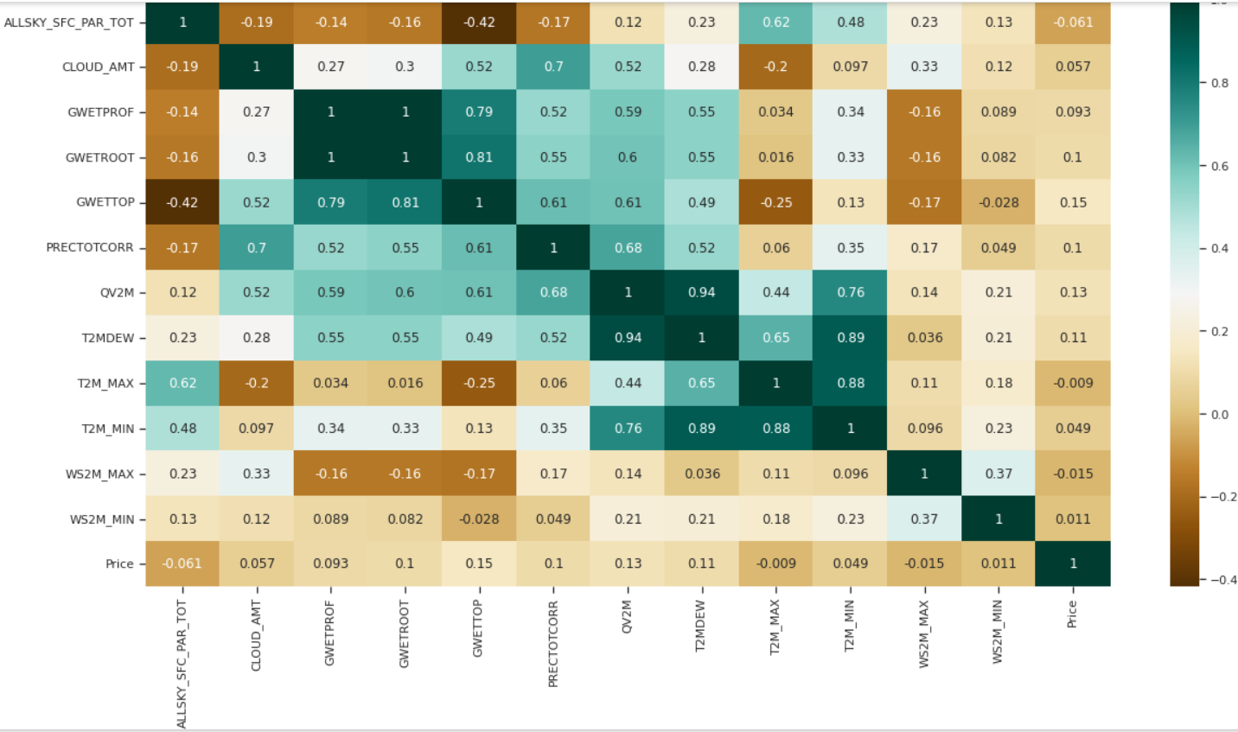
Combining both data frames
Reshaped the data frames for merging
Checked for highly co-related column values

Slide 13
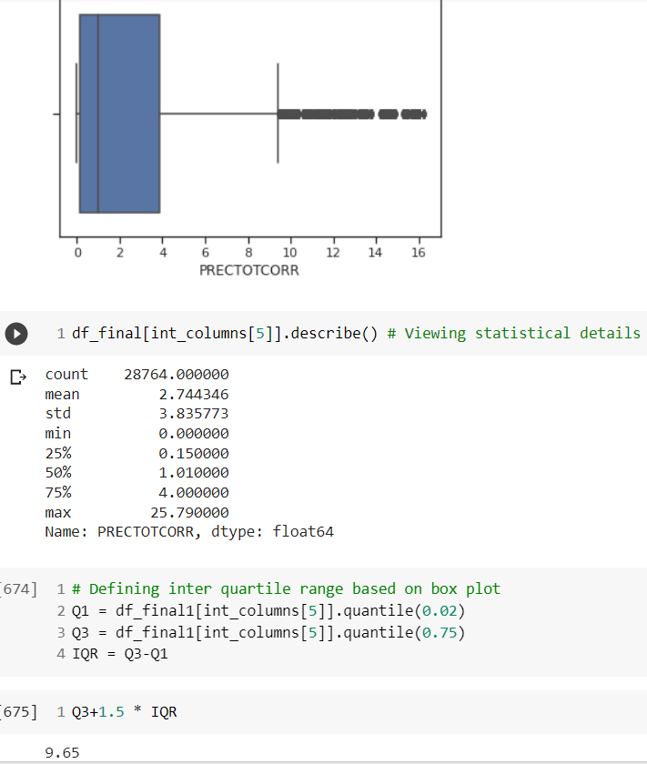
Removed Outliers for each individual columns if any
Code Snippet

Slide 14
Thank You
Goutham Kakani

